Slide 1

NeXt Warning System
Project Board
17 December 2020
10am - 12pm

Slide 2

Agenda
Item | Description | Action | Time | Owner
1 | Introductions and SRO update |  | 10:00 (15mins) | KM
2 | Sign Off Terms of Reference and Roles & Responsibilities | PB Approval | 10:15 (10mins) | PH / KA
3 | XWS Governance and landscape | PB Review | 10:25 (25mins) | PH / KA
4 | FIM Service Challenges | PB Review | 10:40 (25mins) | SL/MS
5 | Alpha Plan and Progress | PB Review | 11:05 (10 mins) | CK / MS
6 | Project Update –Finance/Progress/ Risk and Issues | PB Review | 11:15 (20mins) | PH
7 | Forward Look |  | 11:35 (10 mins) | PH
8 | Action Review | PB Review | 11:45 (10 mins) | KM
9 | AOB |  | 11:55 (5mins) | KA

Slide 3
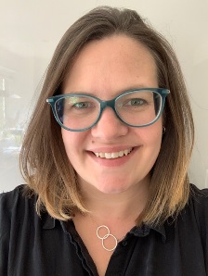
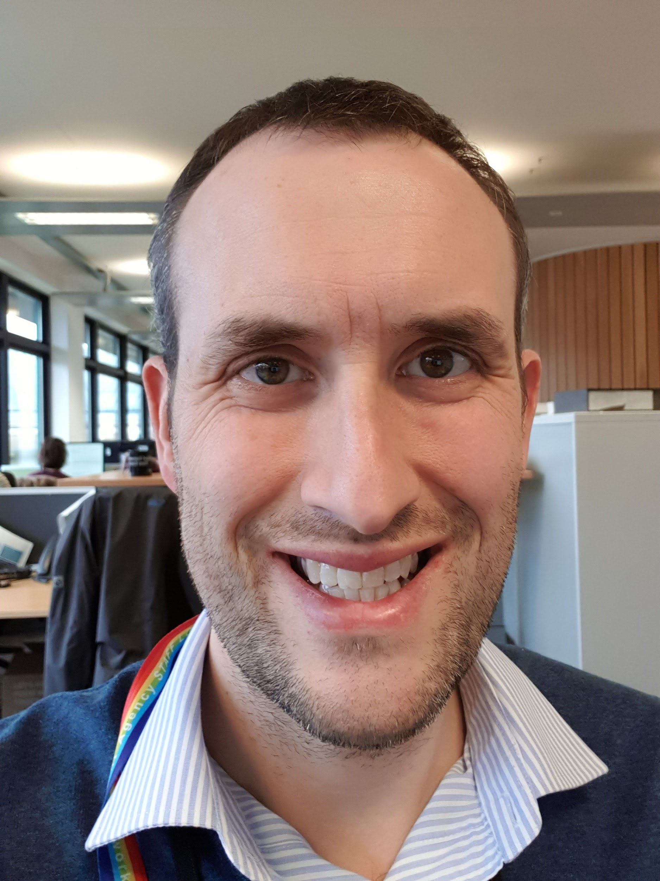
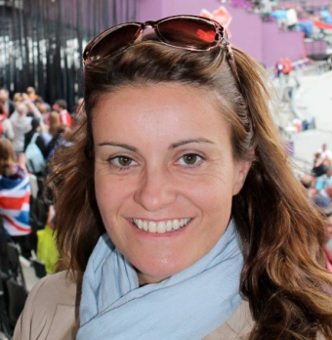


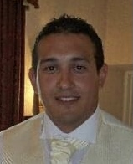

Introductions - Who are we?
Attendees
Kate Marks – Project Sponsor
Karen Alden – Project Executive
Claire Kemp - Senior User / Product Manager
Peter Howe - Project Manager
Paul Brown – Project Support
Mark Sherwood – DDTS Delivery Manager
Stefan Laeger – FIM Service Manager
Melissa Stanard – FIM Service Team (item 4 only)
Lucy Jarvis – Area Flood Resilience TL
Stewart Mounsey – Area Flood & Coastal Risk Manager
Steve White – FWS Product Manager in for YM
Apologies
Yvonne Moore - Service Owner
Alex Hincks – DDTS Senior Supplier
Karen Alden
Claire Kemp
Peter Howe
Kate Marks
Yvonne Moore
Paul Brown
Mark Sherwood
Notes:
Kate to present

Slide 4
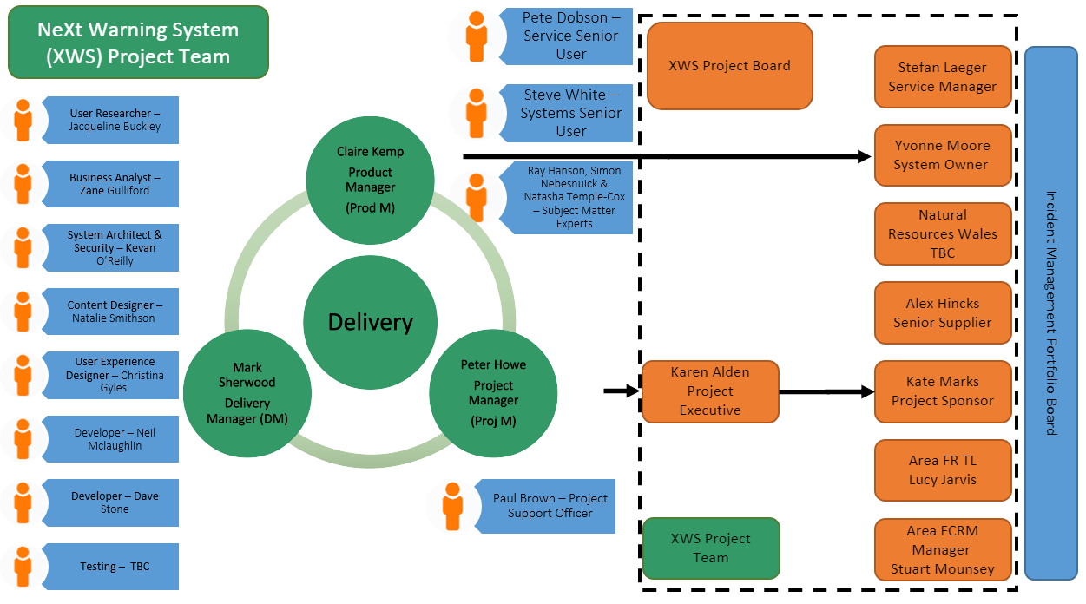
Item 2: XWS Roles
Notes:
Kate to present

Slide 5
Item 2: Sign off XWS Terms of Reference and Roles & Responsibilities
ACTION : After careful review of the XWS ToR and Roles &Responsibilities will the XWS Board support approval of V1.3?
(attached to the appointment and located at the link below)
XWS Roles & Responsibilities V1.3
Notes:
Kate to present

Slide 6
Item 3 : XWS Governance and Landscape
Environment and Business
Incident Management Portfolio Board
X
Future of National Telemetry
Flood Warning Expansion Project Board
IMFS Project Board
FIM Service Improvements
NeXt Warning System Project Board
XWS
FWS CI
EDW
TFWS
Cell Broadcasting
Notes:
Kate to present

Slide 7
Item 3: XWS Work Packages - Outcomes
Core XWS – deliver replacement hazard alerting service to provide continuity of service from FWS by December 2022 making our service simpler, faster, more flexible etc
Extended Direct Warnings (EDW) - separating EDW from our existing Flood Warning System (FWS), reviewing the service we currently provide and make improvements to meet our objectives
Targeted Flood Warning Service (TFWS) - refresh the service ensuring it meets complex (e.g. professional partners) user needs and move existing complex users from FWS to TFWS
Interactive Voice Response (IVR) - separating IVR from FWS, reviewing the service we currently provide and make improvements to meet our objectives
Local Emergency Alerts (Cell Broadcast) - implementing for our flood warning service, some Severe Flood Warnings will be sent to using cell broadcast technology so we can warn people on move
FIM Service Changes - FIM and XWS will continue to work together to review the wider service opportunities and challenges in the light of the new IM/FCRM Strategies and what XWS will enable us to do
Notes:
Kate to present

Slide 8
XWS Landscape: 2020/21 - 2021/22
GDS assessment
Q3 20/21
Q4 20/21
Q1 21/22
Q2 21/22
Q3 21/22
Q4 21/22
Core XWS including Online Registration, Core Engine & Issuing Warnings
Alpha
Private Beta
User research on prototypes
User research & iterate prototypes
Expand Delivery team
Data migration & transition from FWS to XWS
Create formal development environment
Defined architecture & technology
Secure resource to deliver change
Considering architecture & non-functional
Defined MVP with prioritised user stories
User research & build on end-to-end user journey
User journey mapping & event storming
Build & deploy Private Beta
Launch Private Beta
EDW Separation
Discovery & Procurement
Procurement, Commercial & Alpha
Beta
TFWS Refresh
User research on complex user needs & Discovery
Alpha
Beta
IVR Separation
Add feedback to IVR
Discovery
Alpha
Beta
Local Emergency Alerts (Cell Broadcast)
Technical Development
Testing
Business rollout & live in FWS
Notes:
Kate to present

Slide 9
XWS Landscape: 2022/23
GDS assessment
Q1 22/23
Q2 22/23
Q3 22/23
Q4 22/23
Core XWS including Online Registration, Core Engine & Issuing Warnings
Private Beta
Public Beta
Data migration & transition from FWS to XWS
Dual running FWS & XWS
EDW Separation
Detach EDW
TFWS Refresh
TFWS Refreshed
IVR Separation
Beta
Notes:
Kate to present

Slide 10
Item 3: XWS Governance and Landscape
ACTION: What are the XWS Board's views on:
The proposed XWS Governance system
The landscape from 2020/21 - 2022/23
Notes:
Kate to present

Slide 11
Item 4 : Service Opportunities & Implications from XWS (NeXt Flood Warning System)
Melissa Stannard
Claire Kemp

Slide 12
FIM Service Change
FIM and XWS have worked closely together and have considered what the wider Policy and Service opportunities and challenges are in the light of the new IM/FCRM Strategies and what the new warning system enables us to do.
“The Environment Agency will work with partners to transform its warning and informing services to better reach people living, working or travelling though flood risk areas”
FCRM Strategy
We have currently identified our six priority topics for shaping and decisions;
Warning people, rather than property & performance measures
Local Emergency Alerts (Cell Broadcast)
How we communicate uncertainty in flood warnings & use of the flood codes
Automation
Warning for wider hazards
Other changes including Targeted Flood Warning Service Charging and EDW messages
Notes:
Kate to present

Slide 13
XWS Landscape - FIM Service Changes 2020/21 – 2021/22
Q3 20/21
Q4 20/21
Q1 21/22
Q2 21/22
Q3 21/22
Q4 21/22
Warning people, not properties & performance measures
IMPB approval of approach
Internal stakeholder engagement on proposals & wider government links
Develop and trial new flood warning performance measures
Local Emergency Alerts (Cell Broadcast)
Agree business approach and engage with FCRM & IMPB
Implementation through the business
Communicating uncertainty in flood warnings & use of flood codes
Working group exploring options
Message content improvements
XWS & FWEP user research & message content design
Automation
FWEP IT Discovery
System development on XWS, IMFS, FWEP & FoNT
Planning across FIM service
Warnings for wider hazards
Engagement with E&B & FCRM
E&B Discovery ???
XWS Private Beta
Service Changes
Review TFWS charging
Transition FWS professional partners to TFWS
EDW discovery
Review and decide EDW service changes
Review operational messages in FWS
Review and decide operational messages in XWS
XWS Private Beta
Review other potential service changes including frequency of message updates, optional messages, warnings for other languages and flood area definitions

Slide 14
XWS Landscape - FIM Service Changes 2022/23
Q1 22/23
Q2 22/23
Q3 22/23
Q4 22/23
Warning people, not properties & performance measures
Communicate and engage with changes to flood warning performance measures
Communicating uncertainty in flood warnings & use of flood codes
Message content improvements
Automation
System development on XWS, IMFS, FWEP & FoNT
Warnings for wider hazards
XWS Private Beta
XWS Public Beta
Service Changes
Transition FWS professional partners to TFWS
Separate EDW from FWS go live with EDW service changes
Manage operational message business change in area FR teams
Review other potential service changes including frequency of message updates, optional messages, warnings for other languages and flood area definitions

Slide 15
FIM Service Change
Warning people, rather than property & performance measures – XWS & FIM
IMPB have given FIM and XWS the approval to move the service to a ‘contact first’ approach
Wider business engagement to ensure all implications considered, in particular with Defra and the Government
Meet with Defra to provide update on this and wider service changes in the new year
Cell Broadcasting – Digital Services
FIM and Digital Services (DS) working together to agree high level approach by the end of March
Attend FCRM Business Board and IMPB for approvals in Q4
How we communicate uncertainty in flood warnings & use with existing flood codes – FIM (XWS & FWEP)
Working group set up to look at uncertainty in flood warning messages and propose options in Q4
FIM, XWS & FWEP gather user research based on these options
Notes:
Kate to present

Slide 16
FIM Service Change
Automation – FIM (FWEP, FoNT, IMFS & XWS)
Between now and the end of March FIM will work with projects and agree a high level plan of how automation will work across the FIM service
Warning for wider hazards– XWS & SSI
Aspiration that XWS will be a multi-hazard warning system, capable in principle to warn for any hazard including surface water
FIM linking to Strategy and FCRM confirm agree steer on surface water flooding direction (lean in but not step in at this stage)
XWS engaging with E&B to start discovering user needs
Other changes – XWS
DS review options for future TFWS charging and discover user needs for complex users
DS & FIM discovering potential EDW service changes
DS & FIM reviewing use of operational messages
Review other potential warning service changes including frequency of message updates, optional messages, warnings for other languages and flood area definitions
Notes:
Kate to present

Slide 17
Item 4: Service Opportunities & Implications from XWS
ACTION : XWS Board to note the priority service improvement areas and arrangements being put in place to address them.
Notes:
Kate to present

Slide 18

Item 5: XWS Alpha team
What is Alpha? Alpha is where you try out different solutions to the problems you learnt about during discovery. We now have a team that can:
explore ideas and build prototypes
solve the harder potential problems on the project
Who is in our Alpha team?
Mark Sherwood – Delivery Manager
Claire Kemp – Product Manager
Jacqueline Buckley – User Researcher - helps the team learn about the people who will use the service. This will help us design and build a service that works well for all users, including people with a disability and those who need support.
Zane Gulliford – Business Analyst - Business analyst understand business process and analysis user and business needs
Kevan O'Reilly – Architect - designs the infrastructure so that it hangs together to meet overarching Business Needs – Service Availability & resilience, Security, Recovery Time Objectives etc etc
Christina Gyles – User Experience Designer - Designers help the team create user-focused, accessible services and a consistent user experience.
Neil Mclaughlin & Dave Stone – Developers
Content Designer * Starting in January
Notes:
Mark & Claire to present
Mark – What is Alpha
Mark - Delivery Manager
setting up the agile environment your team needs to build and iterate a user-centred service
removing obstacles or ‘blockers’ to progress
helping your service team become better at autonomously organising their own work
making sure accessibility is factored into each feature or activity the team’s working on
Claire - Product Manager
makes sure your service fits in with your organisation’s priorities
define what the future goal of the service is (often called the ‘product vision’ in agile project management)
make sure your service will meet user needs
make sure your service is accessible to everyone, including people who have a disability
prioritise user stories for each work sprint
comment on technical, content and design solutions
accept user stories when complete
Claire - User Researcher - Your user researcher helps your team learn about the people who will use your service. This will help you design and build a service that works well for all your users, including people with a disability and those who need support.
plan and carry out research using a range of methods
involve the team in user research to help everyone develop a deep understanding of your users
create clear findings that help your team continuously improve your service, based on data and evidence
Claire - Business Analyst - Business analysts understand and analyse user and business needs
define what skills a service will need and map where these can be found (eg from an external contractor)
check there’s the budget to cover the proposed approach
analyse how much money your project needs for its ongoing running costs
analyse and map risks and propose solutions
Claire - Architect
work with delivery teams and third parties to decide on technical requirements and improvements for software development and web operation
make sure that new and updated platforms, products, transactions and system architectures are robust, scalable, open and secure
Claire - User Experience Designer
Designers help your team create user-focused, accessible services and a consistent user experience.
Claire - Developers
build accessible software with a focus on what users need from your service and how they’ll use it
advise on the technical feasibility of designs
write, adapt, maintain and support code
continually improve the service with new tools and techniques
solve technical problems
Claire – Content Designer
A content designer is responsible for the content in your service. They contribute to service design by:
developing content plans and strategies based on user needs
writing clear, usable and accessible content in plain English
reviewing content to make sure it’s accurate, relevant, accessible and written in line with GOV.UK style
communicating the principles of content design to your service team and others across your organisation
advocating for users of your service by challenging requests that don’t support their needs

Slide 19
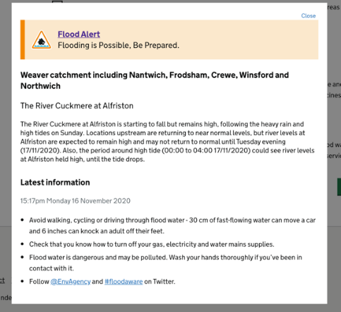
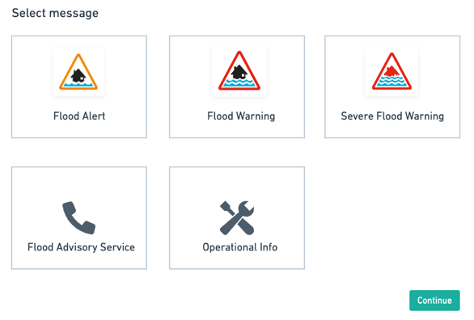
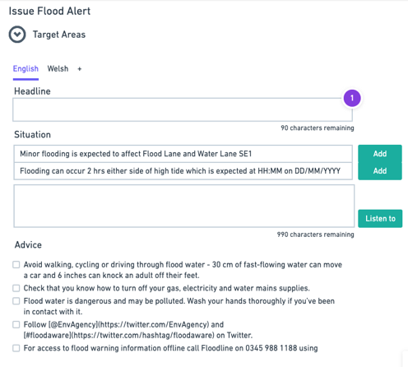
Item 5: XWS Alpha plan & progress – pre Christmas
Alpha team goals – Agree a validated architecture that covers:
Online registration – a citizen (external user) can subscribe and unsubscribe cancel via Online registration service
Message sending – a duty officer can issue, re-issue and update warnings and these can be sent to users and systems
A citizen can receive a warning for an area(s) of interest that they have subscribed to via SMS/email/Phone call and can unsubscribe
User research - recruiting, engaging and running sessions with Internal Users (6) on our message sending prototype and external user (3) on our Online registration prototype
Notes:
Mark & Claire to present
Mark - Goals
Claire - User Research
Run 6 internal user sessions on the message sending prototype, we will be sharing a show and tell session with the minutes with the key findings from these initial sessions:
In these initial sessions we focused on:
Usability of the current system
Likes and dislikes of the current system
Potential improvements
Took users through the pages on the prototype to gather detailed feedback
Users liked the simplicity of prototype
Liked the concept of having the message building in the system & advice section
What we learnt
Areas work in different ways in creating, reviewing and use of the current scripting tool
But general feedback was positive and it is simpler to use than the current system
Where we need to explore further
Extracting additional user needs
How the business is planning to work post XWS launch with roles & responsibilities
Ask areas to help get external users to do user research
AFCRM
FR TL

Slide 20
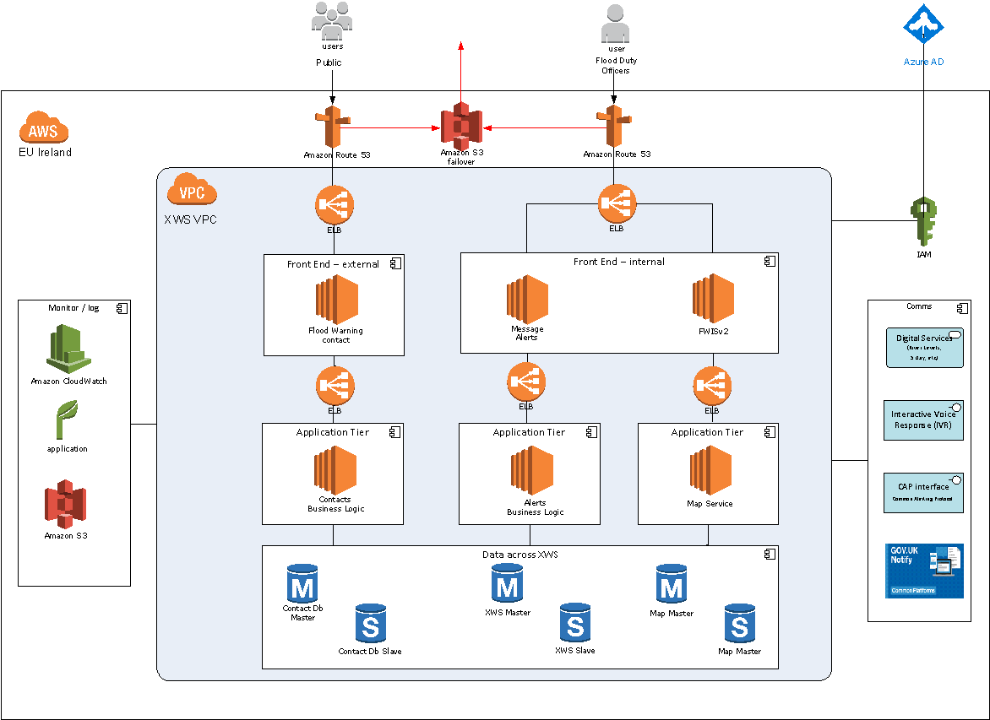
Item 5: XWS Alpha plan & progress – pre Christmas
Non-Functional requirements of the Online Registration and Message Sending elements
Considering how to design the new warning engine including the architecture of the service
Learning the domain through doing and going through the Tuckman (forming, storming, norming & performing) team formation steps
Notes:
Mark to present
Non-functional requirements
Architecture
Conceptual solutions
Technical view
Deployment patterns
Environment definition & purpose
Environment context & costs
Learning the domain
Tuckman

Slide 21
Item 5: XWS Alpha plan & progress – pre Christmas
Not been focusing on:
Offline or Assisted Digital – we assume that Offline user will still contact Floodline or find information via other routes. The new registration process is much easier than the existing method and therefore Floodline will talk AD user through the registration process if required to increase digital uptake as no account management
Links to EDW – Separate to the core engine. Link to the EDW separation discovery in the new year
NRW – no decision as to whether in or out – risk that this will slow down delivery. NRW have confirmed they would require an "account management mechanism"
Admin/Reporting Aspects – not a critical thing to do, but recognise that it's important
We will be running a Show & Share on our progress in Alpha 17 December. This will be shared with the minutes.
Notes:
Mark to present

Slide 22
Item 5: XWS Alpha plan & progress – post Christmas
Alpha Post Christmas Goal Link (Work in Progress)
Defining our minimum viable product (MVP) and prioritise our user needs
Further engagement and research with internal and external users and iteration of prototypes
Defined architecture & technology
User Journey Mapping & Event Storming (needs External Digital Services input)
Alpha Assessment
Notes:
Mark to present

Slide 23
Item 5: XWS Alpha plan & progress
ACTION : Does the board have any questions on our Alpha goals pre & post Christmas?
Notes:
Kate to present

Slide 24
Presentation Interval
After presenting three priority subjects for XWS, do you have any questions?
Notes:
Kate to present

Slide 25
Item 6: Project Plan Q4
January
February
March
Complete Outline Business Case
XWS Benefit Mapping Workshop
Scope prioritisation workshop
EA / SEPA – SEPA to introduce their objectives & timescales
Compile options evaluation matrix
Investigate 1 year contract extension as a contingency
Evaluate the short list
DDTS cost estimation of short list options
Feasibility note on a 12-month contract extension with Fujitsu
Technical Alpha ends
Market comparison against DDTS price list for the preferred option
NRW & SEPA decision
Start drafting the OBC
Prepare for Alpha assessment
EA / NRW – Answer NRW queries
Notes:
Kate to present

Slide 26
Item 7: Forward Look
21 January
TFWS Discovery
25 February
EDW Discovery
Cell Broadcasting
24 March
IVR Separation
Sign off to proceed to GDS Alpha Assessment
Review Draft Outline Business Case
Alpha assessment plan
Notes:
Kate to present

Slide 27
Item 8: Action Review
No | Action | Owner | Date
1 | Arrange a meeting for Frazer, Alex, Stefan and Karen to speak further on the blended approach that XWS is using (agile vs traditional approach). | KA | TBC
2 | Project board members to raise any changes to the ToR or Roles & Responsibilities with Karen | Project Board | 14/10/20
3 | Clarify what is in scope and what is for others following the Discovery Report findings | KA (CK) | 21/10/20
4 | Agree at IMPB for Discovery report to be published | KA (PH) | 21/10/20
5 | Revisit wording of objective 3 and 6 to ensure efficiency (reduced running costs) and resilient people are taken into account (see notes below). | KA | TBC
6 | Set up benefits workshop | KA (PH) | 30/11/20
7 | Work up the service issue risk to clarify what will be delivered /timescales | SL | 20/11/20
8 | Final comments from PB on the SOC by 14th Oct | Project Board | 14/10/20
9 | Itemise business change costs on a separate line in budget | PH (KA) | TBC
10 | Set up future project board meetings as agreed | PB (PSO) | TBC
Notes:
Kate to present

Slide 28

Item 9: Any Other Business
Thank you for listening and engaging at the NeXt Warning System Project Board.
Any questions?
Notes:
Kate to present

